Slide 1

CineSense: Your Go To Movie Recommender System Major Project KCS 753/ 7th Sem
STUDENT NAME:
1.Dev Bhardwaj(2000320120069)
2.Jatin Kumar(2000320120090)
3.Khushi Agrawal(2000320120096)
4.Radhika Gupta(2000320120129)
SUPERVISOR NAME:
Ms. Anshul Khanna
Assistant Professor
CS Department

Slide 2
ABSTRACT
CineSense is an innovative movie recommendation system designed to enhance the cinematic experience of viewers by providing personalized and engaging film suggestions. In an era inundated with an abundance of movie choices, CineSense leverages cutting-edge machine learning algorithms and user-centric data analysis to curate tailored movie recommendations, ensuring that users discover films that resonate with their unique preferences.
The proposed system leverages machine learning algorithms to personalize the movie-watching experience, provide feedback to users, and optimize content recommendations.
Moreover in this, we use some frontend technologies to make our website look more attractive to the user. In this, the user will get the sliding panel and some popup dialogues that will recommend the movie which would be connected to the machine learning algorithms.
The proposed movie recommendation system has the potential to revolutionize how movies and shows are discovered, offering users a more personalized and enjoyable cinematic experience.
CineSense is poised to revolutionize the way audiences discover and engage with movies, offering a holistic and personalized movie recommendation experience that combines the art of cinema with the science of machine learning.

Slide 3
OBJECTIVE
● "CineSense - Your Go-To Movie Recommender” aim is to create a cutting-edge streaming platform like Netflix, Amazon prime enriched with a sophisticated recommendation system, powered by data from The Movie Database (TMDB). 'CineSense' seeks to provide users with an immersive cinematic experience, aligning seamlessly with their preferences and interests.
● By harnessing TMDB's extensive dataset, the project will dynamically curate content suggestions for users. Through advanced algorithms analyzing viewing habits, genres, and historical data, 'CineSense' will deliver personalized recommendations, enhancing user engagement and satisfaction.
● The undertaking will encompass comprehensive full-stack development, encompassing responsive front-end design for an intuitive user interface and a robust back-end infrastructure for seamless content delivery. The integration of user profiles, content categorization, and streaming functionality will be pivotal to the platform's success.
● Through 'CineSense,' proficiency in web development, API integration, and data-driven decision-making will be showcased. Ultimately, the success of this project will be measured not only by its replication of Netflix's or Amazon prime’s familiar features but also by the implementation of an innovative recommendation system that enriches user interaction, making it a 'little big' advancement in the realm of content streaming platforms."

Slide 4
Scope the Problem Statement
The ' CineSense - Your Go-To Movie Recommender System ' project involves creating a streaming platform resembling Netflix, enhanced with a personalized recommendation system driven by TMDB data
The project will encompass user profiles, content library, streaming capabilities, responsive UI, and an advanced recommendation algorithm.
The scope also includes backend setup, API integration, and deployment.
By achieving these goals, 'CineSense - Your Go-To Movie Recommender System' aims to showcase expertise in full-stack development, API utilization, and user-oriented design, contributing to an innovative content discovery experience."

Slide 5
LITERATURE REVIEW
S.No : 1
TITLE :React JS – An Emerging Frontend Javascript Library
AUTHORS : Pratik Sharad Maratkar , Pratibha adkar
Year of Publication : 2021
Journal/Conference/Book Chapter Name: IRE Journals
Technology / Algorithm Used : HTML, Java Script, React Js, Css
Summary :The paper focuses on the importance of the React JS library and how it has brought new dimensions to web application development. React JS accelerates the application efficiency and it can be seen that React JS has a wider scope as well worth the effort. It also focuses on how React uses reusable Components to design an attractive UI.
Gap :React only deals with the View from MVC therefore we need other tooling to finish the backend development too .Reacts environment changes so fast that developers often find it difficult to adopt to the new changes, relearn and implement them.

Slide 6
LITERATURE REVIEW
S.No : 2
TITLE : Over The Top (OTT) Platform using Reactjs
AUTHORS : Md. Ashraf , G. Rithwik , T Sai Sriram, M Vasavi
Year of Publication : 2023
Journal/Conference/Book Chapter Name: CVR Journal of Science and Technology
Technology / Algorithm Used : React Js, Css
Summary :This paper focuses on how the OTT platform are taking the place of cable Tv and how the telecommunications company are in loss along with this it discusses the suitability of React.js for building OTT (Over-The-Top) platforms and highlight its advantages, such as maintainability, outstanding performance through the virtual DOM, and a rich ecosystem of tools like Redux and React Router. There is an implementation of an OTT. IT also mentions future prospects, including personalization, and integration with emerging technologies like VR and voice assistants to further improve OTT platforms.
Gap : It does not tell about the use of hooks in React JS and there can be some cons of React too like heavy codes , less documentation available . Don’t tell us how to fetch data as per user choice.

Slide 7
LITERATURE REVIEW
S.No : 3
TITLE : A systematic review and research perspective on recommender systems
AUTHORS : Deepjyoti Roy, Mala Dutta
Year of Publication : 2022
Journal/Conference/Book Chapter Name: Journal of Big Data
Technology / Algorithm Used : Machine Learning
Summary : We have identified and prudently reviewed research papers on recommender systems focusing on diverse applications, which were published between 2011 and 2021. This review has gathered diverse details like different application fields, techniques used, simulation tools used, diverse applications focused, performance metrics, datasets used, system features, and challenges of different recommender systems.
Gap: Deployment challenges such as cold start, scalability, sparsity, etc. Challenges faced when employing different recommender algorithms for different applications, In collecting implicit user data, and in handling real-time user feedback.

Slide 8
LITERATURE REVIEW
S.No : 4
TITLE: Research Paper On Recommendation System
AUTHORS : Dr. Alka Singhal, Shivangi Rastogi, Nikhil Panchal, Shivani Chauhan, Shradha Varshney
Year of Publication : 2021
Journal/Conference/Book Chapter Name: Global Scientific Journals
Technology / Algorithm Used: Collaborative Filtering , Content Based Filtering, Cosine Similarity
Summary: This paper focuses on how recommendation systems Work in the real world and IT scenarios. Recommendation systems, which automatically understand user preferences and make recommendations, are now widely used. The recommendation system is one of the major technologies for implementing personalization services. Recommendation systems in ubiquitous IT environments should have the capability of context-knowledge
Gap: A major concern here is respecting people’s privacy. The second challenge is to create recommendation algorithms that combine multiple types of information, probably acquired from different sources at different times.

Slide 9
LITERATURE REVIEW
S.No : 5
TITLE: Movie Recommendation System
AUTHORS: Jose Immanuvel. J,Sheelavathi. A , Priyadharshan. M, Vignesh. S, Elango. K
Year of Publication : 2017
Journal/Conference/Book Chapter Name: International Journal for Research in Applied Science and Engineering Technology
Technology / Algorithm Used: Score point Matching, Rating System, Machine Learning
Summary: Movie recommendation system proposed whose primary objective is to suggest a recommended list through singular value decomposition, collaborative filtering and cosine similarity. The very common purposes where the recommender system is applied are OTT platforms, search engines, articles, music, videos etc during this work we tend to propose a Collaborative approach-based Movie Recommendation system.
Gap : These techniques discover the rating pattern from historical data and give highly accurate and effective recommendations from some sample data.

Slide 10
LITERATURE REVIEW
S.No : 6
TITLE : High Rating Recent Preferences Based Recommendation System​
AUTHORS : Sanjeev Dhawana , Kulvinder Singhb , Jyoti​
Year of Publication : 2017​
Journal/Conference/Book Chapter Name: Procedia Computer Science​
Technology / Algorithm Used :​ Machine learning
Summary : The main objective of this research is to build a collaborative filtering recommender system that is able to compute the item-to item similarity between any two movies using three different similarity measures: Pearson similarity, Cosine based similarity and Euclidean distance measure. The main goal is to integrate all three measures in a single system. This system generated high rated recommendations only, i.e. the movies which are rated greater than equal to three will be recommended to users to improve the quality of recommendations. ​
Gap : The performance can be enhanced by distributing the recommender algorithm over multi-core, multi-thread online systems. One can directly implement the technique in distributed manner on Apache Spark or Mahout.​

Slide 11
LITERATURE REVIEW
S.No : 7
TITLE :Movie Recommendation System Using Machine Learning
AUTHORS : F. Furtado , A Singh
Year of Publication : 2020
Journal/Conference/Book Chapter Name: IJRIE - International Journal of Research in Industrial Engineering
Technology / Algorithm Used : Content based and collaborative filtering
Summary : The main aim of recommendation system is to reduce human effort by suggesting movies based on the user’s interests. A model combining both content-based and collaborative approach is used. As most of the users do not provide ratings, the rating matrix becomes very sparse, this system bridges this gap .Improves sparsity by making rating as mandatory. The problem of over-specialization is resolved using neighborhood-based collaborative techniques.
Gap : Here more importance is given to rating characteristics than various properties.

Slide 12
LITERATURE REVIEW
S.No : 8
TITLE : Movie Recommendation Algorithm Using Social Network Analysis to Alleviate Cold-Start problem
AUTHORS :Khamphaphone Xinchang, Phonexay Vilakone, Doo-Soon Park
Year of Publication :2019
Journal/Conference/Book Chapter Name: Journal of Information Processing
Technology / Algorithm Used : Machine learning
Summary : In this paper, a movie recommendation system is proposed by using social network analysis and collaborative filtering to solve this problem associated with cold start. In this paper,they proposed an alternative approach for the recommender system using both SNA and CF .Personal propensity of users such as age, gender, and occupation is applied to make relationship matrix between users, and the relationship matrix is applied to cluster user by using community detection based on edge betweenness centrality.
Gap : The implementation processed in this paper using R programming took a very long time. Therefore, we propose to reduce the experiment time.

Slide 13
LITERATURE REVIEW
S.No : 9
TITLE : Implementation of online product recommendation system using collaborative filtering
AUTHORS : Shivani Patel and Pooja Songadkar
Year of Publication : 2019
Journal/Conference/Book Chapter Name: International Journal of Advanced Research
Technology / Algorithm Used : Machine Learning
Summary :The proposed system uses a combination of collaborative filtering and content based recommendation system also known as personality based approach. CB uses principal component analysis for dimensionality reduction similar to UV decomposition for UV matrix. The main ideology behind using a hybrid system is to use all the available data optimally.
Gap : In this, web applications are developed and web services in particular suffer from producing recommendations of innumerable items to millions of users. The time and computational power can restrain the performance of even the best hybrid systems available.

Slide 14
LITERATURE REVIEW
S.No : 10
TITLE: Film Saga – A movie recommendation system using machine learning
AUTHORS : Namyapriya D
Year of Publication : 2022
Journal/Conference/Book Chapter Name: International Journal for Research Trends and Innovation
Technology / Algorithm Used : demographic filtering, content based filtering
Summary :This movie recommender system utilizes datasets from Kaggle and employs various filtering algorithms. It starts with demographic filtering based on weighted ratings and quantile functions. Next, it implements content-based filtering, considering factors like cast, crew, genre, and unique keywords using cosine similarity. Additionally, emotion/mood-based filtering is incorporated via web scraping to match user preferences, ratings, genres, and emotional content. The system is accessible through a Flask Micro Web framework in Python for web applications and also for React applications.
Gap :The memory capacity should be increased so that the system loads the data and its rating for a longer period without any data loss and We can increase the precision and make our recommendation more relative and personalized.

Slide 15
LITERATURE REVIEW
S.No : 11
TITLE : MovieGEN: A Movie Recommendation
AUTHORS : E. A.Tilak, G., &Li. N.
Year of Publication :2019
Journal/Conference/Book Chapter Name: IJRIE
Technology / Algorithm Used : genre correlation, content based filtering
Summary :This paper focuses on developing movie recommendation systems, which predict user preferences based on previous search history, liked movies, and attributes like genre, ratings, and tags. The system employs content-based filtering with genre correlation. It also explores enhancing the website's front-end for a more appealing user experience. Upon entering search criteria, users are redirected to a results page, displaying recommended movies with details, similar to the user's input, primarily based on genre and cast using content-based filtering with high similarity scores.
Gap :The user data is always useful in recommender systems. It needs to collect more user data and add a user dislike movie list. Input of dislike movie list into the recommender system as well and generate scores that will be added to previous result. By this way we can improve the result of recommender system

Slide 16
LITERATURE REVIEW
S.No : 12
TITLE: Personalized web based application for movie recommendations
AUTHORS : Killian Duay
Year of Publication :2019
Journal/Conference/Book Chapter Name: IJRASET
Technology / Algorithm Used : React JS , TMDB
Summary : The paper focuses how to build the whole architecture that allows users to log in to the application, search for movies, add them to their profile and get recommendations. The whole architecture contains a backend, a frontend, a database and several Application Programming Interfaces (APIs). Each part of this architecture could be implemented in different ways and the selected technologies should be presented to recommend the content of user choice.
Gap : The main challenge is to integrate the recommendation system with the web application and the database used is not updated regularly.

Slide 17
LITERATURE REVIEW
S.No : 13
TITLE: The Recommender System: Operations Research in OTT-Platforms
AUTHORS :SAnoushka Shah , Ansh Rathod , Arnav Jain , Aryan Chopra
Year of Publication :2021
Journal/Conference/Book Chapter Name: International Journal of All Research Education and Scientific Methods
Technology / Algorithm Used : Hungarian Assignment method
Summary :This paper highlights the challenge faced by OTT platforms in recommending diverse and appropriate content to users despite advanced recommender systems. It proposes a unique recommender system based on users' genre preferences and viewing history, using the Hungarian Assignment method from operations research .The paper suggests future enhancements like user surveys and continuous updates to adapt to changing viewer preferences, ultimately aiming to improve the OTT experience.
Gap :The randomly generated numbers to solve assignment problem could be a limitation to the efficiency of the recommender system. The proposed method cannot recommend latest movies. The system does not account for shifts in the user's preferences over time unless there is a collection of new data and a repetition of the process

Slide 18
LITERATURE REVIEW
S.No : 14
TITLE: Content Recommendation System
AUTHORS :Ayush Mishra, Malhaar Waghela, Madhavi Gavade, Asst Prof. Odilia Gonsalves
Year of Publication : 2021
Journal/Conference/Book Chapter Name: International Research Journal of Engineering and Technology
Technology / Algorithm Used : Content and collaborative filtering
Summary : This paper highlights the recommendation of content using content as well as collaborative filtering .The proposed system is effective in providing much more accurate and fast results. The system proves to be time-saving and requires less maintenance. This system is useful and easy to use and has a very attractive user interface so many users will surely give try to this. Many users like to watch regional languages movies, So they can watch that by getting a recommendation system
Gap : Collaborative filtering systems suffer from the 'sparsity' and 'new user' problems also cannot handle new movies while content based filtering The model can only make recommendations based on existing interests of the user. In other words, the model has limited ability to expand on the users' existing interests

Slide 19

LITERATURE REVIEW
S.No : 15
TITLE: Netflix Recommendation System based on TF-IDF and Cosine Similarity Algorithms​
AUTHORS : Mohamed Chiny, Marouane Chihab, Omar Bencharef, Chihab Younus​
Year of Publication : 2022​
Journal/Conference/Book Chapter Name: International conference on big data, modeling and machine learning ​
Technology / Algorithm Used : TF-IDF , Cosine Similarity​
Summary : Netflix is a leading on-demand streaming platform accessible in 190 countries, offering a vast library of movies and TV shows. It utilizes TF-IDF and Cosine similarity algorithms, common in Natural Language Processing (NLP), for its recommendation system. Exploratory analysis has unveiled intriguing insights into Netflix's content trends. Although the current recommendation system has limitations, its potential shines when incorporating additional features​
Gap: However, this approach is a starting point towards a more sophisticated recommendation system that considers other features such as the show’s duration, the Netflix score, the leading players, etc.​

Slide 20
Proposed Methodology :
UI Design and Component Creation with React JS:
Conducted user research to understand preferences and expectations for OTT platform design. Create wireframes and design reusable UI components using React JS to make it interactive. Implement Tailwind CSS for styling to ensure a visually appealing and responsive interface.
Backend Development with Firebase:
Set up Firebase for user authentication and real-time data storage. Develop backend functionalities for user data storage, authentication, and interaction tracking. Implement Firebase Cloud Functions for server less logic.
Data Integration from TMDB and YouTube:
Obtain API credentials from TMDB and YouTube for accessing movie data and trailers. Develop API integration modules to fetch movie data, including titles, genres, ratings, and trailers. Display data on the website components, such as top-rated, upcoming, and comedy movie sections.
User Authentication and Account Management:
Implement user authentication using email and password through Firebase. Create signup and login functionalities for new and returning users. Enable users to save movies for later viewing by implementing a 'like' or bookmark feature.
Machine Learning Integration:
Implement data collection and preprocessing to gather user interaction data. Utilize machine learning techniques such as Cosine Similarity Calculation to analyze user preferences. Develop ranking and recommendation generation algorithms based on user behavior and interactions.

Slide 21
Homepage and Navigation Bar:
Design and implement the homepage with sections like top-rated, upcoming, and comedy movies. Create a nav-bar for easy user access to different sections of the website.
Trailer Playback:
Integrate the functionality to play movie trailers directly from YouTube. Enhance user experience by allowing users to preview movies before deciding to watch.
Security Measures and Data Privacy:
Implement encryption and secure data storage practices to ensure user privacy. Adhere to data protection regulations and ethical considerations in handling user information.
Documentation:
Provide comprehensive documentation for users on website features and functionalities.
Deployment and Hosting:
Deploy the website to a hosting environment, ensuring scalability and performance. Monitor hosting infrastructure for optimal performance and user experience.
User Engagement and Future Developments:
Encourage user engagement through surveys and feedback. Identify areas for future developments, updates, and enhancements to the website

Slide 22
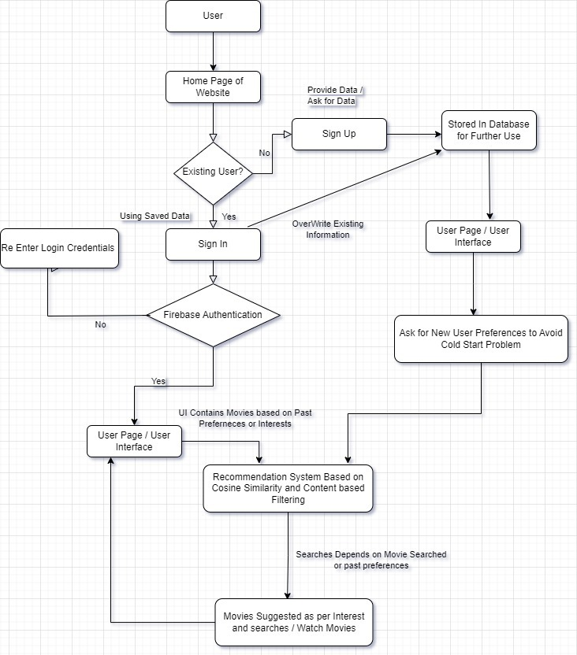
Flow Chart:

Slide 23
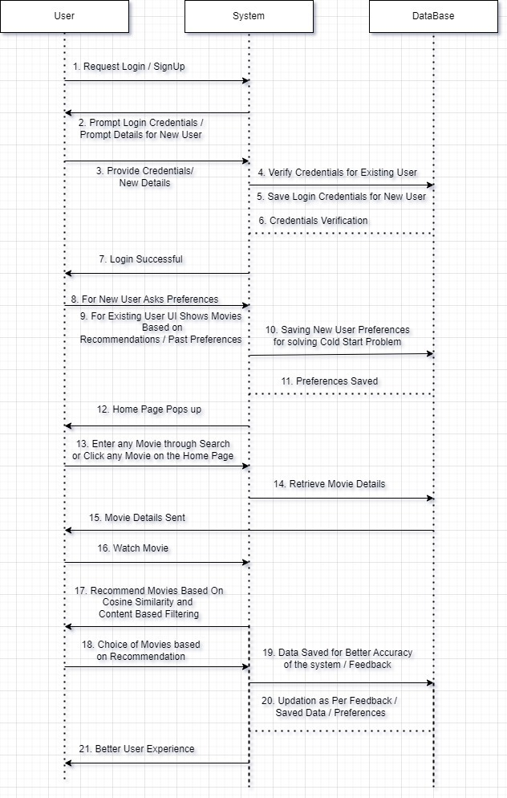

Slide 24
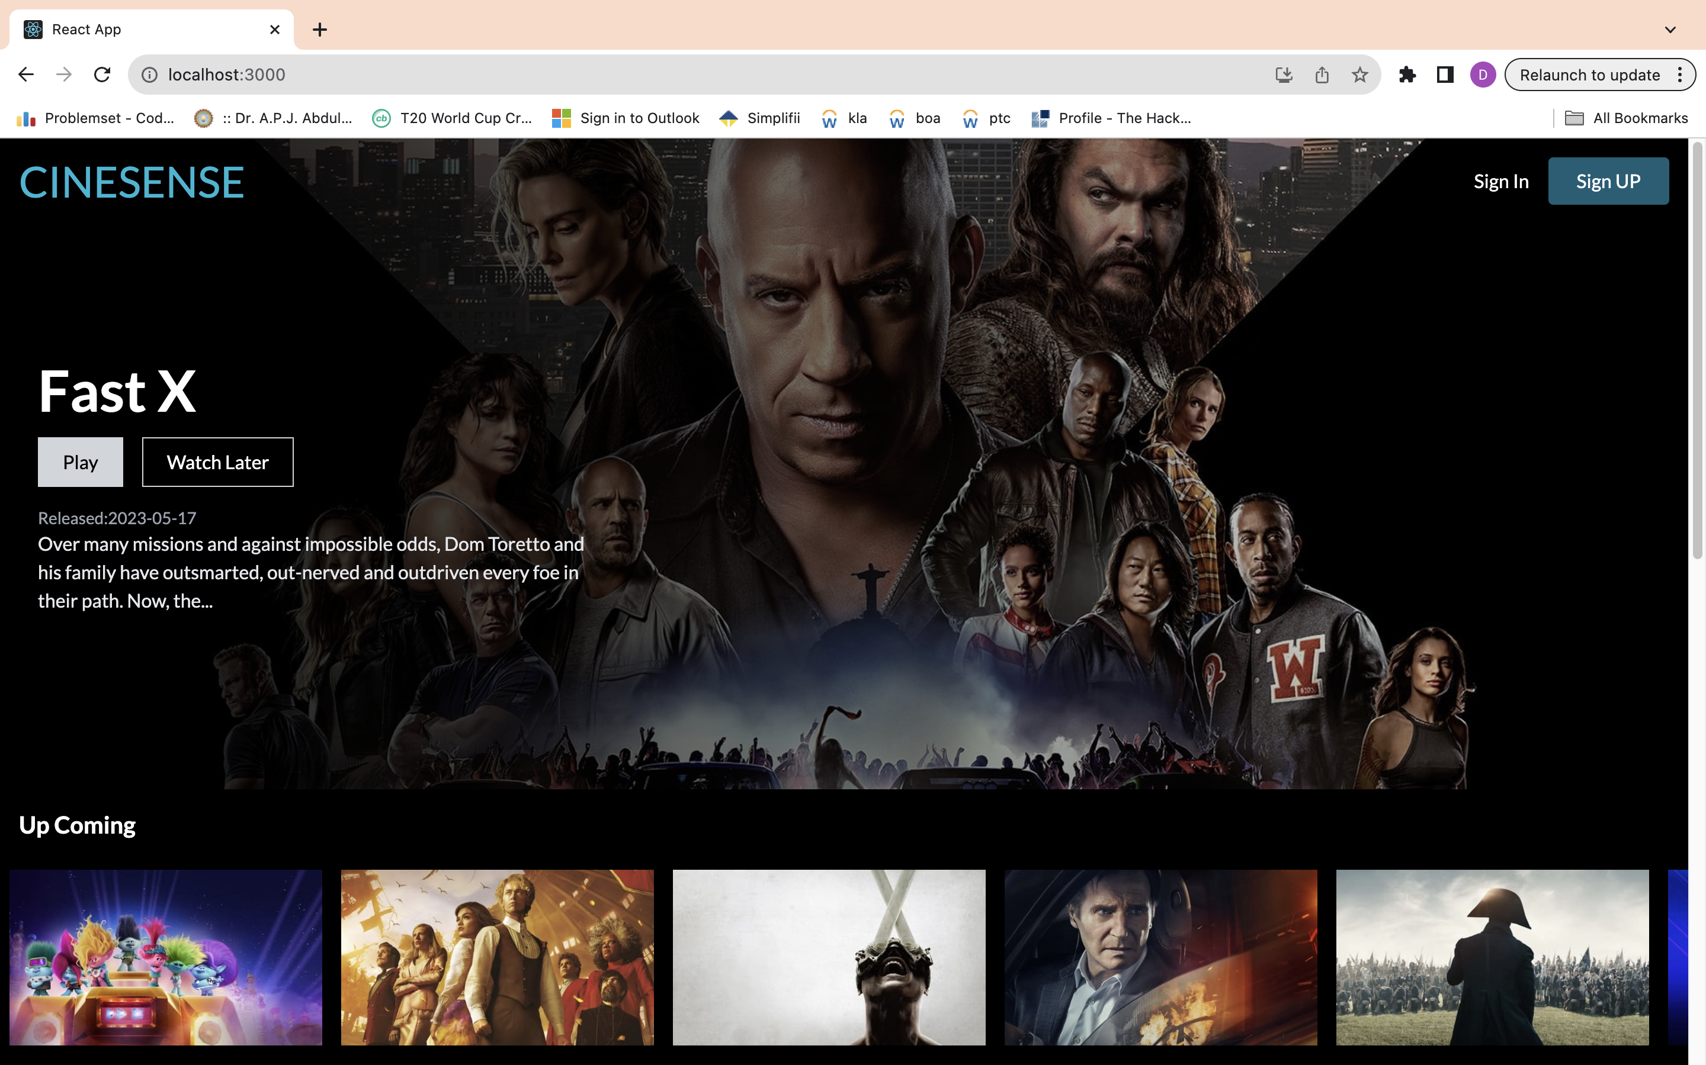
Implementation

Slide 25
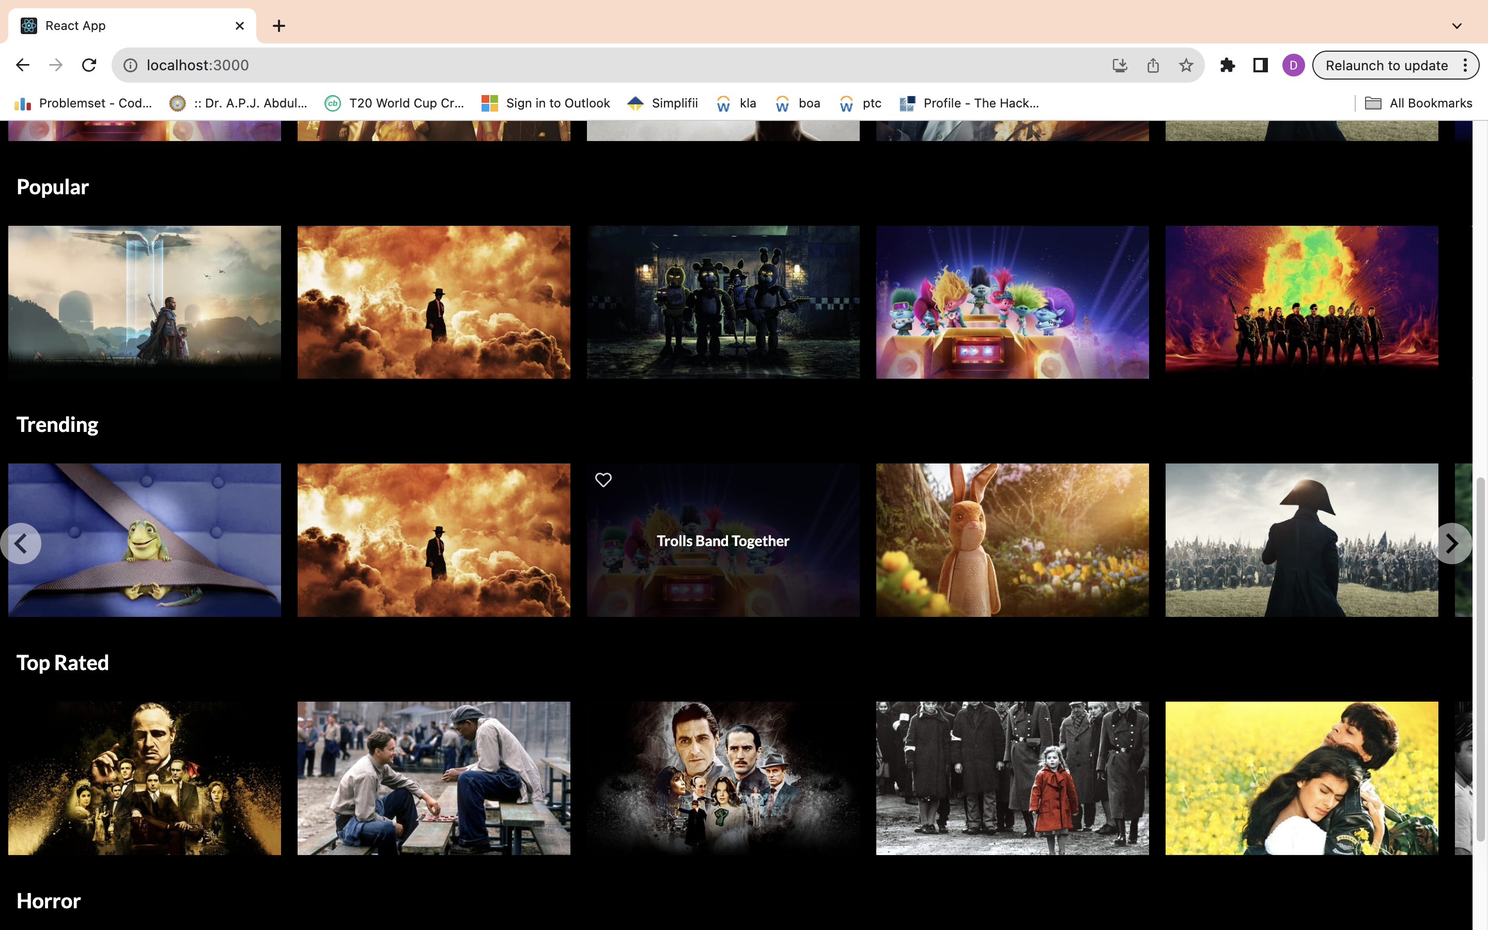

Slide 26
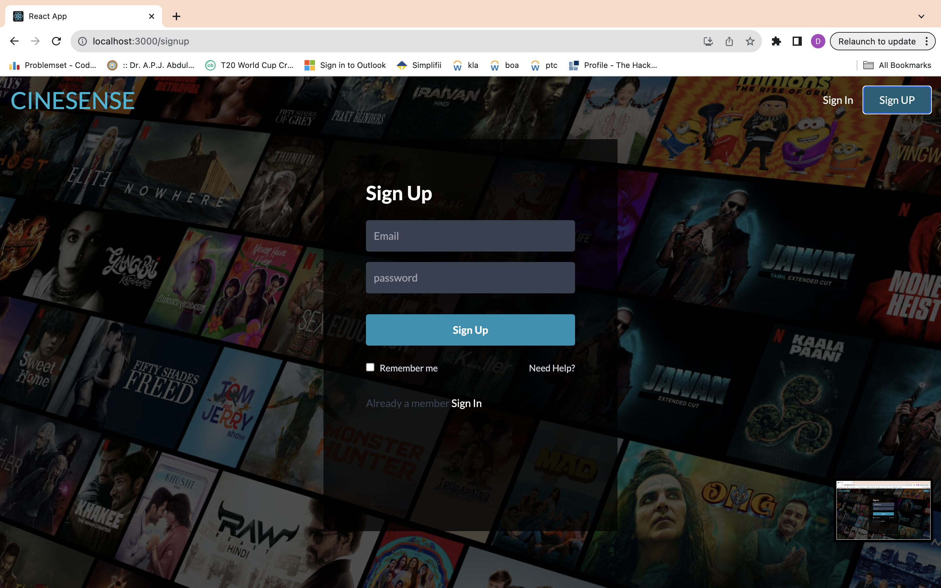

Slide 27
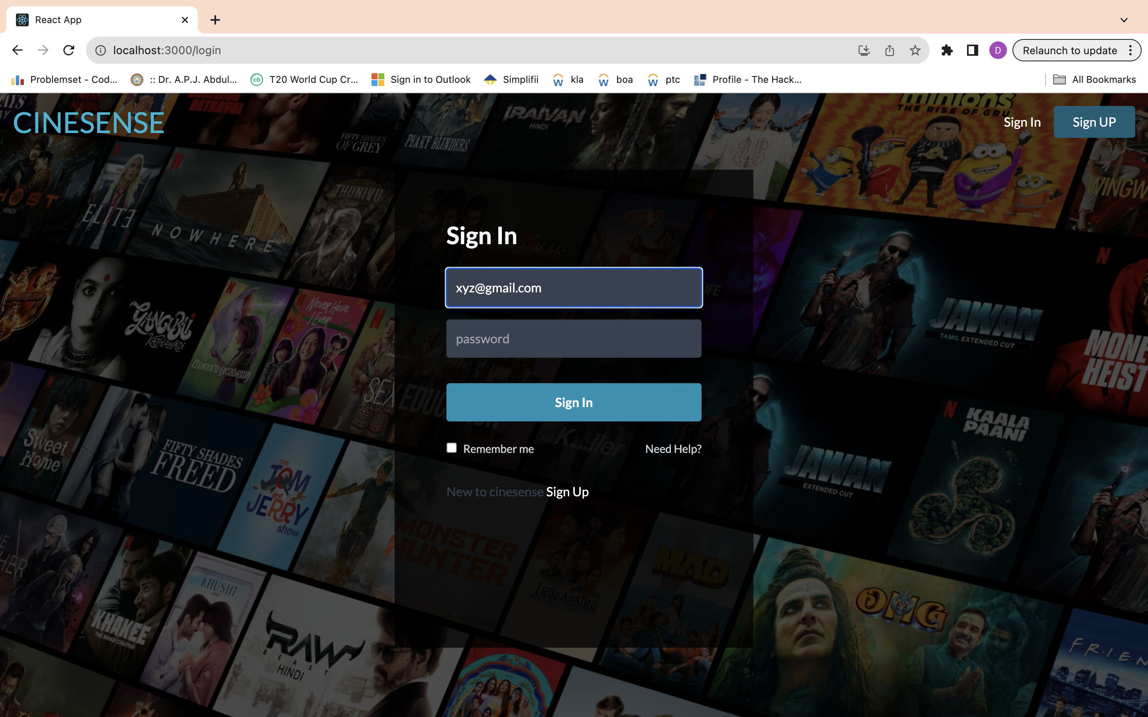

Slide 28
Conclusion and Future Scope
The expected outcomes of a movie recommender system can vary depending on its design, implementation, and purpose. However, here are some common expected outcomes:
● Improved User Satisfaction
● Increased User Engagement
● Higher Content Consumption
● Extended User Sessions
● Increased Revenue
● Reduced Decision Fatigue
● Enhanced Personalizations
The specific outcomes will depend on the goals and implementation of the recommender system. Success can be measured through metrics like user engagement, user satisfaction surveys, increased content consumption, and, in the case of commercial platforms, improved revenue metrics. Continuous monitoring and refinement of the system are often necessary to achieve and sustain these outcomes.

Slide 29
Tools and Technologies used
VS Code,
React JS,
Tailwind css,
Firebase,
TMDB,
Machine Learning
Jupyter
Recommendation system

Slide 30
References
[1] Pratik Sharad Maratkar , Pratibha adkar, “React JS – An Emerging Frontend Javascript Library”,IRE Journals 2021.
[2] Md. Ashraf , G. Rithwik , T Sai Sriram, M Vasavi , “Over The Top (OTT) Platform using Reactjs” CVR Journal of Science and Technology 2023.
[3] Deepjyoti Roy , Mala Dutta ., “A systematic review and research perspective on recommender systems”, Journal of Big Data 2022.
[4] Dr. Alka Singhal, Shivangi Rastogi, Nikhil Panchal, Shivani Chauhan, Shradha Varshney, “Research Paper On Recommendation System” , Global Scientific Journals 2021
[5] Jose Immanuvel. J, Sheelavathi. A , Priyadharshan. M, Vignesh. S, Elango. K., “Movie Recommendation System”,International Journal for Research in Applied Science and Engineering Technology 2017.

Slide 31
References
[6]. Sanjeev Dhawana , Kulvinder Singhb , Jyoti, “High Rating Recent Preferences Based Recommendation System”,Procedia Computer Science 2017.
[7]. F. Furtado , A Singh. “Movie Recommendation System Using Machine Learning”, IJRIE - International Journal of Research in Industrial Engineering 2020
[8] Khamphaphone Xinchang, Phonexay Vilakone, Doo-Soon Park “ Movie Recommendation Algorithm Using Social Network Analysis to Alleviate Cold-Start problem”, Journal of Information Processing Systems 2019.
[9] Shivani Patel and Pooja Songadkar, “Implementation of online product recommendation system using collaborative filtering” International Journal of Advanced Research 2019.
[10] Namyapriya D, “Film Saga – A movie recommendation system using machine learning” International Journal for Research Trends and Innovation 2022.

Slide 32
References
[11] E. A.Tilak, G., &Li. N.. “MovieGEN: A Movie Recommendation” IJRIE 2019.
[12]. Killian Duay,“Personalized web based application for movie recommendations .” IJRASET 2019.
[13] SAnoushka Shah, Ansh Rathod, Arnav Jain, Aryan Chopra, “The Recommender System: Operations Research in OTT-Platforms”,International Journal of All Research Education and Scientific Methods 2021
[14] Ayush Mishra, Malhaar Waghela, Madhavi Gavade, Asst Prof. Odilia Gonsalves, “Content Recommendation System” ,International Research Journal of Engineering and Technology 2021.
[15] Mohamed Chiny, Marouane Chihab, Omar Bencharef, Chihab Younus, “Netflix Recommendation System based on TF-IDF and Cosine Similarity Algorithms”,International conference on big data, modeling and machine learning 2022.

